Slide 1

FinHelp
Komal Nirania

Slide 2


Slide 3


Slide 4
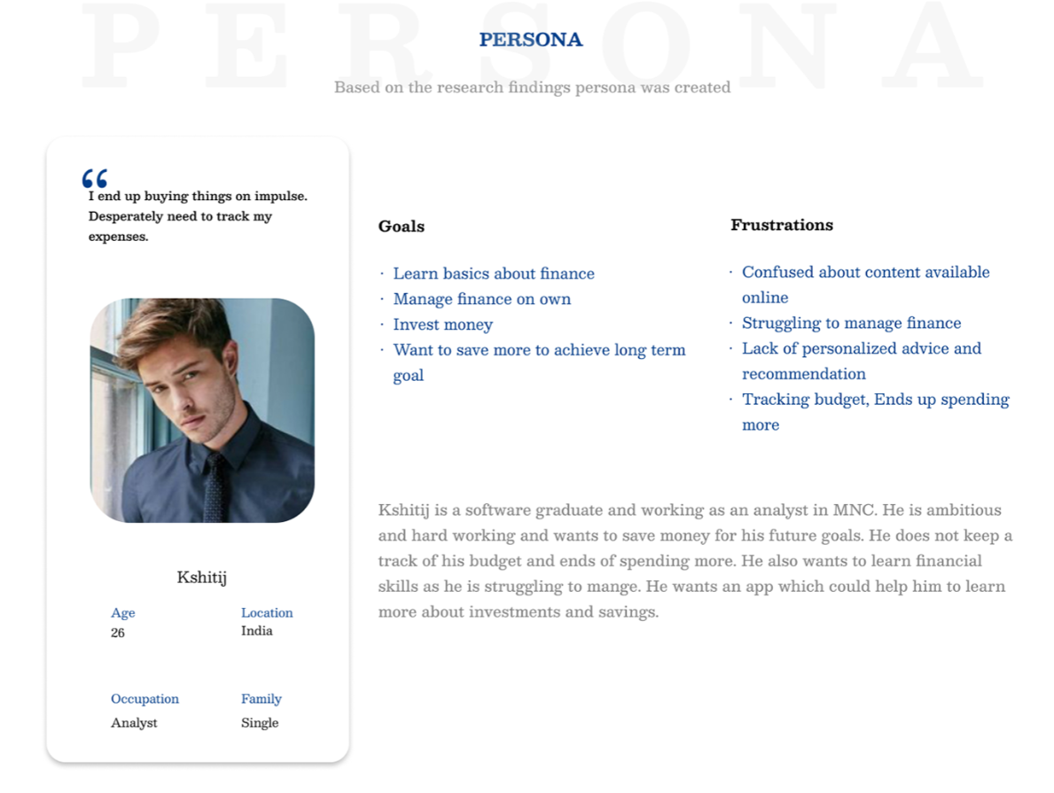

Slide 5
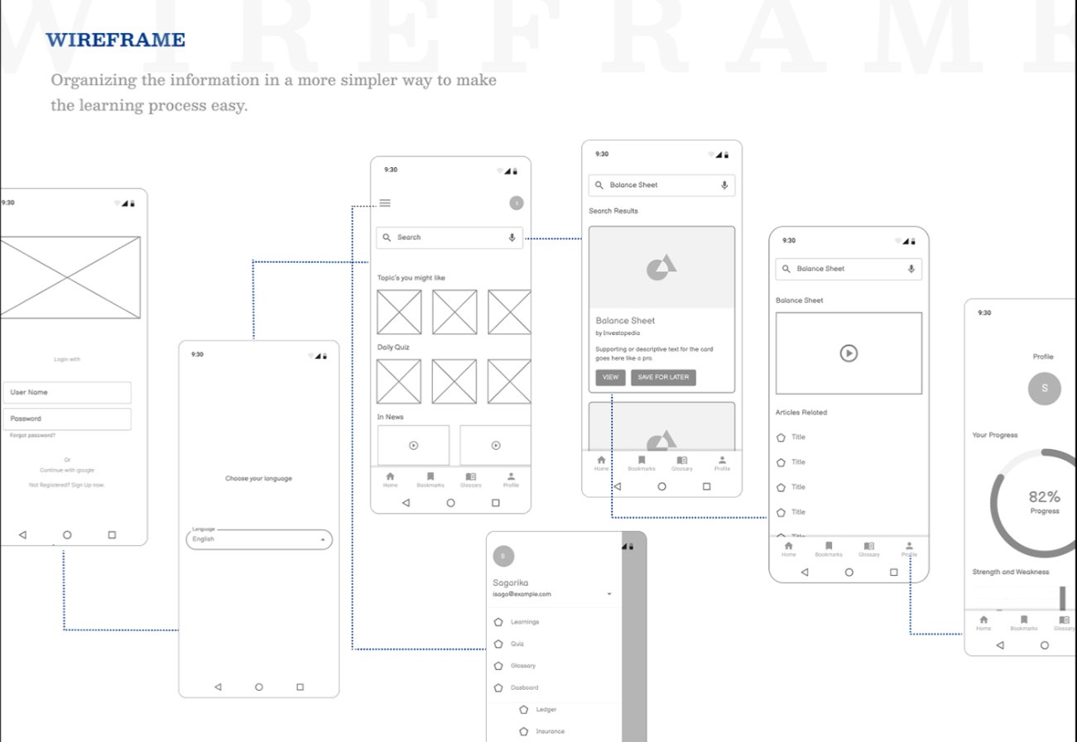

Slide 6
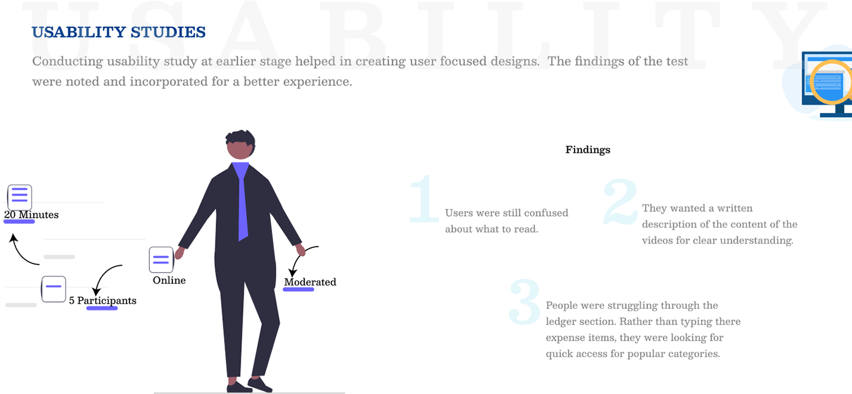

Slide 7
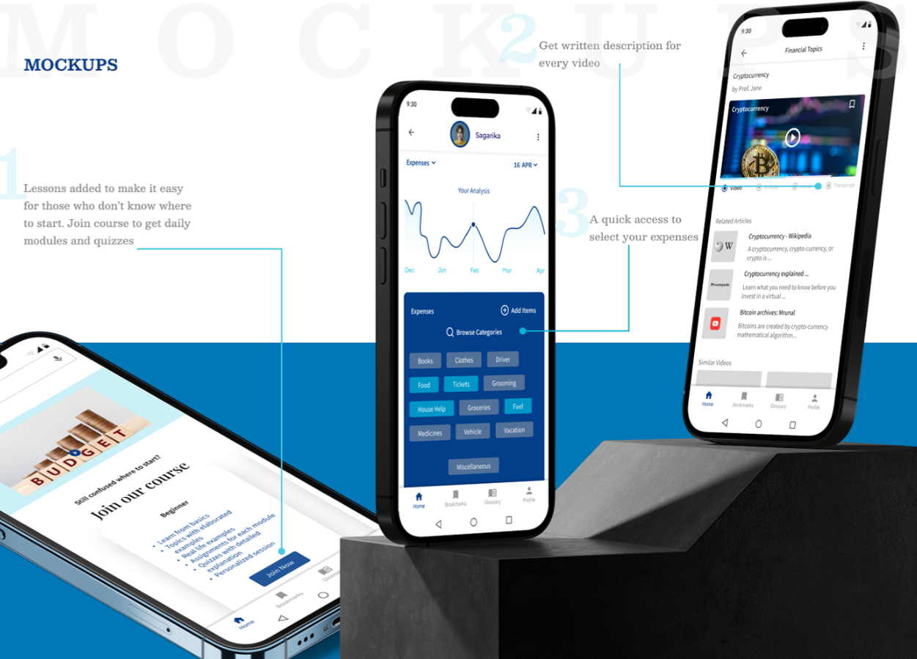

Slide 8
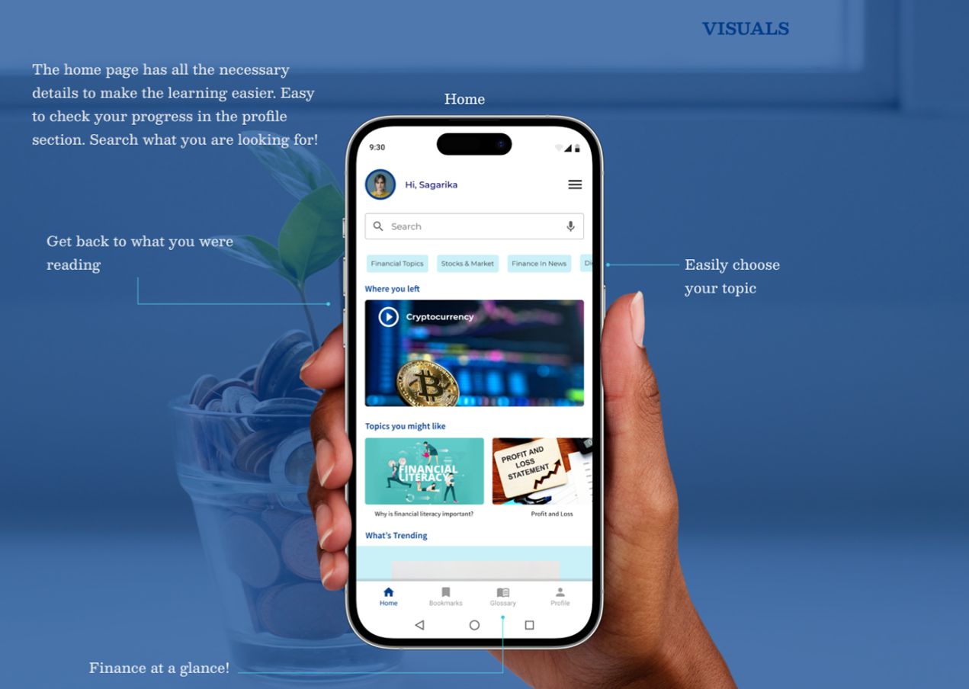

Slide 9
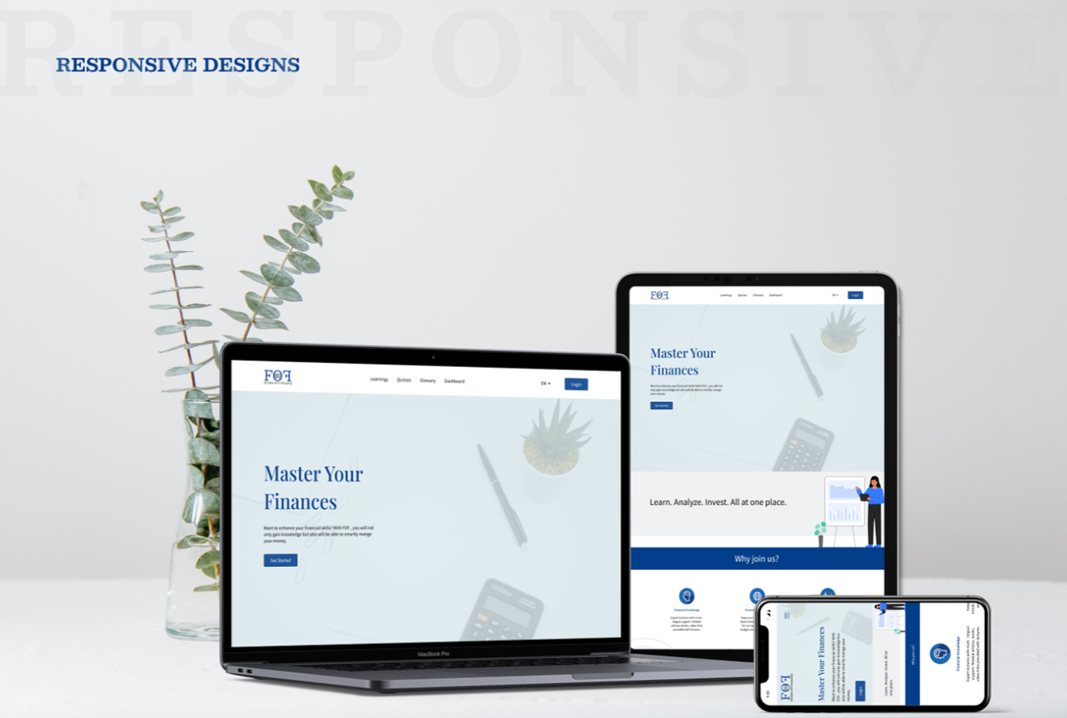

Slide 10
Insert a few sentences summarizing the next steps you would take with this project and why. Feel free to organize next steps in a bullet point list.
Let’s connect!
Thank you for your time reviewing my work on the FloralFusion app! If you’d like to see more or get in touch, my contact information is provided below.
Email: n.komal@iitg.ac.in
LinkedIn: https://www.linkedin.com/in/komalnirania

